Slide 1
Oral Presentation Guidelines

Slide 2
Purpose of this Presentation
This presentation provides the recommended guidelines for preparation of the RFIC 2025 Podium Presentations and is an electronic template.
The file you are reading has settings, colors, and fonts that make it easy to read.
You may edit this file and replace our slides with your presentation’s contents.

Slide 4
A 29-30GHz 64-element Active Phased Array for 5G Application
Example
WE1A-4
K. Bao¹, J. Zhou^{1,2}, L. Wang¹, A. Sun¹, Q. Zhang¹, and Y. Shen^{1,2}
¹Nanjing Electronic Devices Institute, Nanjing, China
²Science and Technology on Monolithic Integration Circuits and Modules Laboratory, Nanjing, China

Slide 5

Student
Paper
Finalist
For Student Paper Finalists
Add badge in the upper right corner of title slide

Slide 6
Industry
Paper
Finalist
For Industry Paper Finalists
Add badge in the upper right corner of title slide

Slide 7
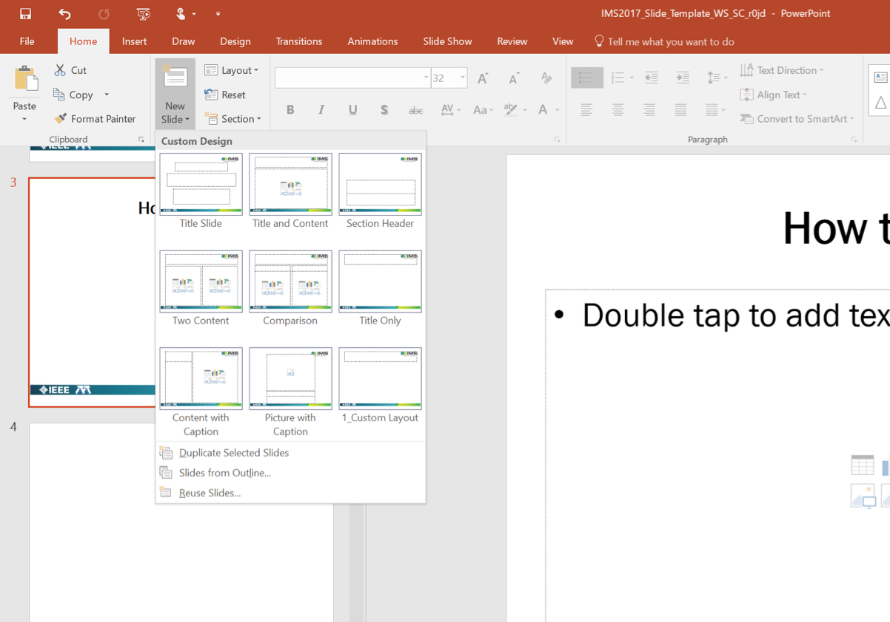
How to Use
Use the provided templates and recommended fonts and sizes

Slide 8
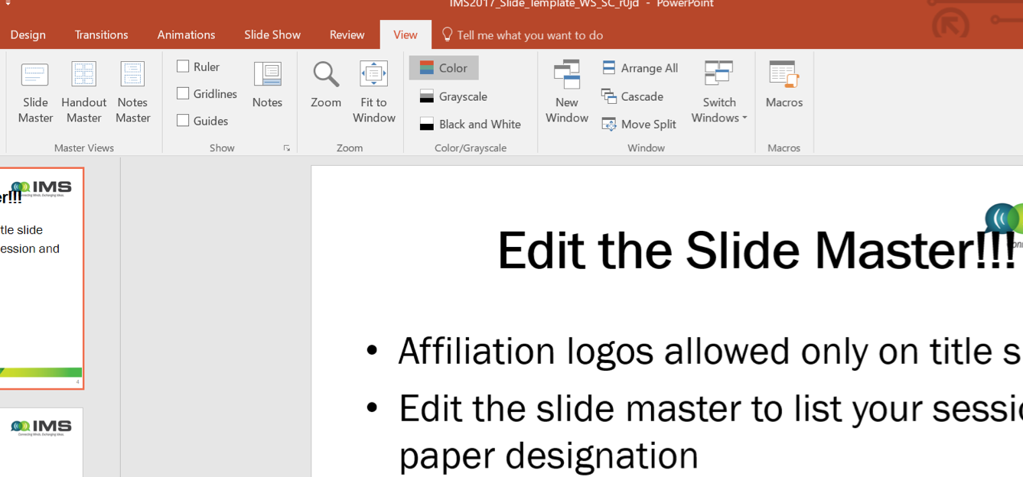
Edit the Slide Master!!!
Affiliation logos are allowed only on the title slide
Edit the slide master to list your session and paper designation
For example: MO1A - 4

Slide 9
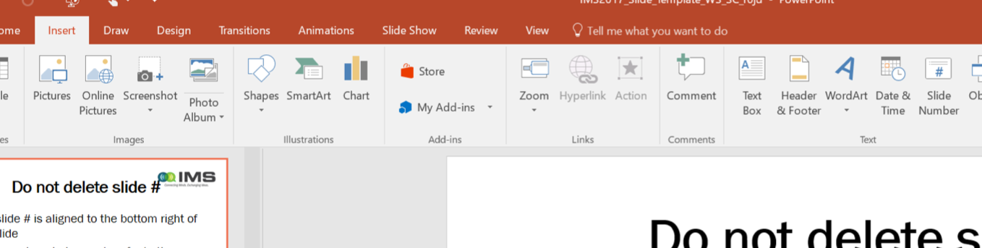
Make sure you have the slide #
The slide # is at the center of the slide
Slide numbers help guests refer to them later
Insert slide # if they get deleted

Slide 10
Typical Presentation Flow
Title slide
Outline slide of your talk
Introduction / Motivation / Problem or Challenge
Details of work
State how your results compare to other reported work
Conclusion slide
Backup slides if desired
Remember to leave time for questions as part of your timeslot

Slide 11
Style Guidelines
Use short phrases, not long sentences
Use Calibri (or similar) sans serif font
  This line uses Helvetica 24 pt
  This is Calibri 24 pt
  This line uses Arial
28 Point or larger for titles
This font is 16 pt. If you use fonts that are smaller than 18 pt, people in the back of the room may not be able to read your slide.

Slide 12
Special Fonts or Symbols
Watch out for:
  Wingdings
  MS line draw
  Monotype sorts
  Symbol fonts
  Asian language fonts
Please embed TrueType fonts

Slide 13
Style Guidelines (Cont.)
The targeted time for one slide is 1 to 2 minutes
Each slide should have a title
Limit ~ 9 lines of text
Limit ~ 7 words per line
Slides sized for “On Screen Show”
Slide orientation: Landscape (16:9)

Slide 14
Contrast
Choose high contrast font colors
Use dark lines/text on a light background
  Foreground: Black, Blue, Red
  Background: White
  Caution: yellow, grey or cyan lettering and lines may be unreadable when projected

Slide 15
Display Speed
Slides should display without delay
Do not distract the audience with
any transition effects
Avoid the use of slow graphics, fonts, and special effects
Do not use sound effects

Slide 16
Diagrams
Keep diagrams
  Simple
  Easy to view
Make all texts readable by using large fonts
Use all the available space
Do not use borders

Slide 17
Graphs
Use graphs and avoid tables if possible
Keep graphs simple
Eliminate or subdue distracting grid lines
Use large font sizes including axes labels
You do not need to apologize for presenting an “eye chart” if you do not present one.

Slide 18
Summary
Keep your slides simple
Use large fonts for high visibility
Use high-contrast colors
Present the highlights, not the details

